Slide 1

EvoBug: Genetic Algorithm Framework for Mutation Testing
Improving Test Effectiveness for Python & Java Programs
Notes:
Introduce EvoBug as a genetic algorithm framework designed to improve mutation testing for Python and Java programs.

Slide 2

Overview
EvoBug uses genetic algorithms (GA) to enhance mutation testing
Targets small Python and Java programs adapted from LeetCode
Traditional random testing often fails to uncover deep behaviors
Modifies inputs to maximize killed mutants
Integrates MutPy for Python mutation testing
Provides interface, pipeline, reproducible scores and histories
Notes:
Explain EvoBug’s purpose: overcoming limitations of random testing by using GA to maximize killed mutants.

Slide 3

Motivation
Mutation testing is widely used for robust test suites
Challenge: Generating effective inputs
Random methods can be shallow → lower mutation scores
EvoBug leverages GA to adapt input construction over time
Goal: Evaluate if GA outperforms random testing
Notes:
Discuss why mutation testing is important and the challenge of generating effective inputs. Highlight GA’s role in improving efficiency.

Slide 4
Technique & Implementation
Six LeetCode-style problems: reverse_string, rotated_sort, roman_to_int, supersequence, two_sum, duplicate_digits
Each problem includes domain constraints, target function, random input generator, GA chromosome interpreter, baseline tests
Notes:
Describe how problems were selected from LeetCode and standardized with components like INPUT_SPEC, target_function, and BASE_TESTS.

Slide 5

Architecture & Scoring
GA initializes population with valid constraints
Evolution: selection, crossover, mutation
Fitness evaluation driven by mutation testing (score + killed mutants)
MutPy executes modules and returns scores
Records best & average fitness per generation
Notes:
Explain GA architecture: population initialization, selection, crossover, mutation, and fitness evaluation based on mutation scores.

Slide 6

Pipeline & Results
Unified runner automates evaluation lifecycle
Executes GA runs and random testing for comparison
Collects mutation scores, fitness histories, performance stats
Outputs JSON summaries for downstream processing
Includes visualization components for plots
Notes:
Walk through the pipeline: automated runs, GA vs random testing, result collection, JSON summaries, and visualization.

Slide 7

Experimental Results
GA converges to high mutation scores early
Preserves strong solutions across generations
GA matched or outperformed random testing on all benchmarks
Greater complexity → larger performance gap
Notes:
Highlight experimental results showing GA outperforming random testing, especially as complexity increases.

Slide 8
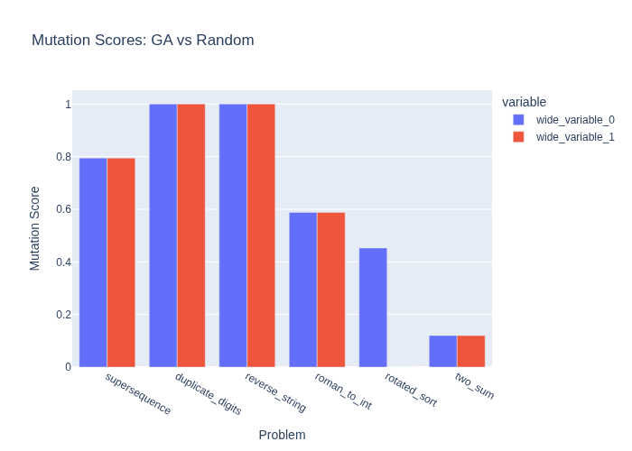
Mutation Scores Comparison
Notes:
Explain the mutation score table and how GA compares to random testing across different problems.

Slide 9

Discussion & Conclusion
EvoBug shows benefits of GA-guided mutation testing
Standardized interface enables cross-problem comparisons
MutPy integration ensures realistic mutant behavior
GA outperforms random testing as complexity grows
Fitness histories reveal evolutionary progress
Notes:
Summarize findings: GA improves mutation testing, integrates MutPy, and provides reproducible results.

Slide 10

Future Work
Extend to complex codebases and input spaces
Explore hybrid methods (GA + random seeding)
Optimize with parallelization/distributed testing
Investigate alternative evolutionary strategies
Notes:
Discuss future work: scaling to complex codebases, hybrid methods, and optimization techniques like parallelization.

Slide 11
Key Takeaways
EvoBug improves mutation testing using genetic algorithms.
Outperforms random testing on LeetCode problems.
Provides reproducible results and visualizations.
Future work includes scaling and hybrid approaches.
Notes:
Explain GA Architecture diagram: each component’s role in evolutionary progress.

Slide 12

Thank You
Notes:
Describe Pipeline diagram: flow from problem modules to visualization and result analysis.

